Slide 1

Web Development Foundations
04
JavaScript Fundamentals

Slide 2
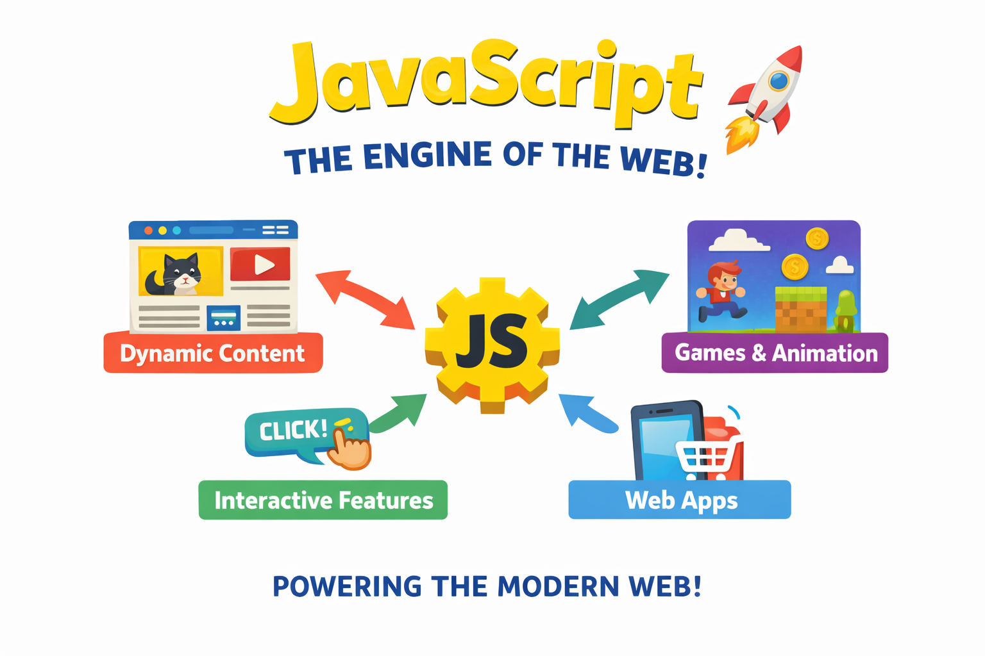
Part 1: The Engine of the Web

Slide 3
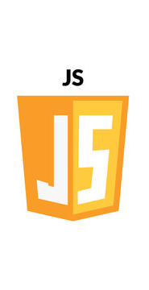
Variables & Data Types
The Browser Console
Variables
const vs let
Primitive Data Types
Strings, Numbers, Booleans
Complex Data Types
Arrays and Objects

Slide 4
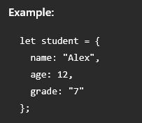
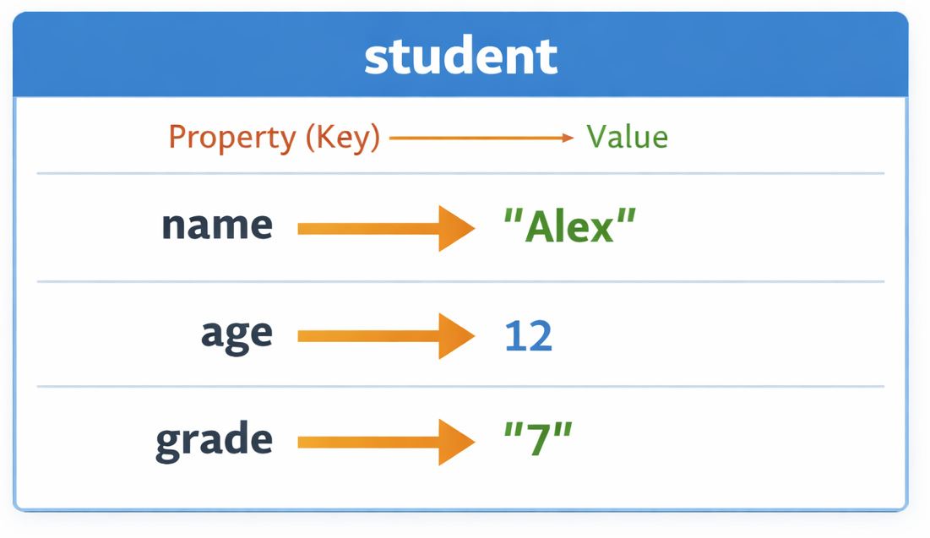
Objects in JavaScript
An Object stores data using key - value pairs. It is like a product label with name, price, and expiry date.
How it works:
Each value has a label (key).
You access data using the key name.
Accessing data:
student.name // "Alex"
student.age // 12

Slide 5
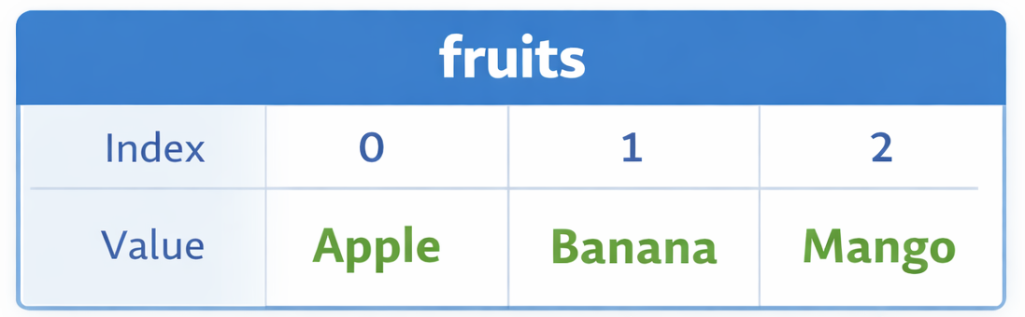
Arrays
An Array is a list of values stored in a single variable. It is like a shopping list.
Example:
let fruits = ["Apple", "Banana", "Mango"];
How it works:
Each item has a position called an index.
Index starts from 0.
Accessing data:
fruits[0] // "Apple"
fruits[1] // "Banana"

Slide 6
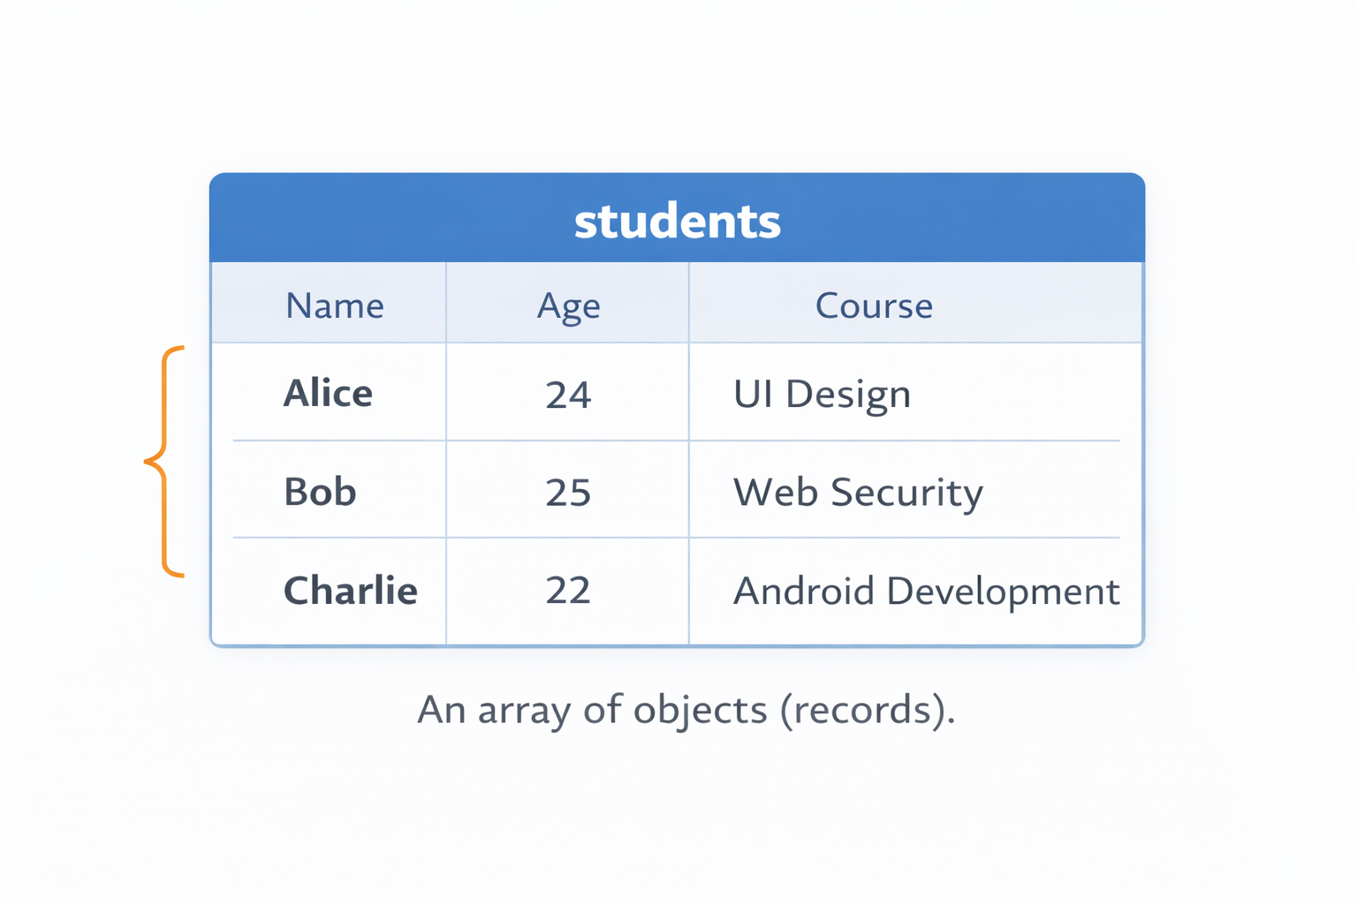
Arrays of Objects
In the real world, we usually come across Arrays of Objects as a data structure
Example:
const students = [ {name: ‘Alice’, age: ‘24’, course:’UI Design’}, {name: ‘Bob’, age:’25’, course:’Web Security’}, {name: ‘Charlie’, age: ‘22’, course: ‘Android Development’} ]
Accessing Data:
students[1].course // Web Security
students[0].name //Alice

Slide 7
Demo
Demo: Create a profile object for a user.
Mini-Challenge: "Create an array of your three favorite movies and log the second movie to the console."

Slide 8
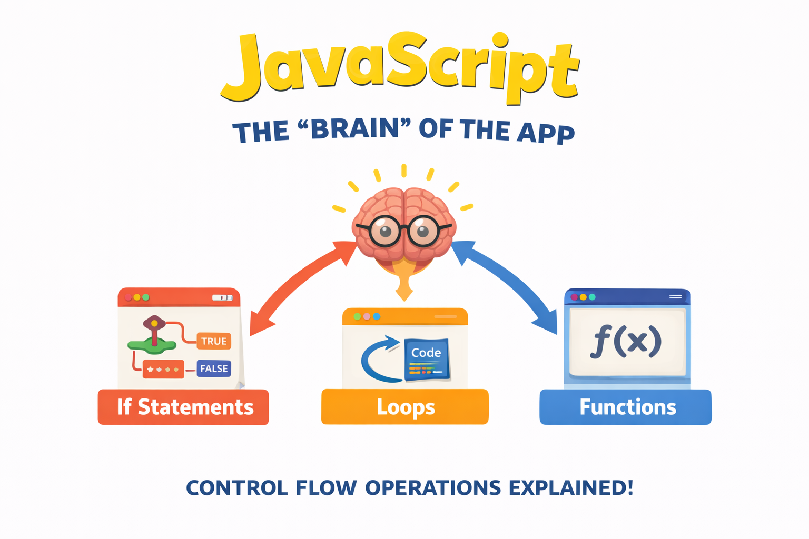
Part 2: The Brain
CSS: Cascading Style Sheets

Slide 9
Control Flow
Conditionals: if, else if, and else.
Comparison Operators: === vs == (The Importance of Strict Equality).
Logical Operators: && (AND), || (OR), ! (NOT).
Loops: The for loop and the modern forEach.
Source: w3schoools.com

Slide 10
Interactive Activity #1
ATM Machine
Task: Write an algorithm for an ATM Machine.
Example: If balance > withdrawal AND pin is correct, THEN

Slide 11
10
Minute Break

Slide 12
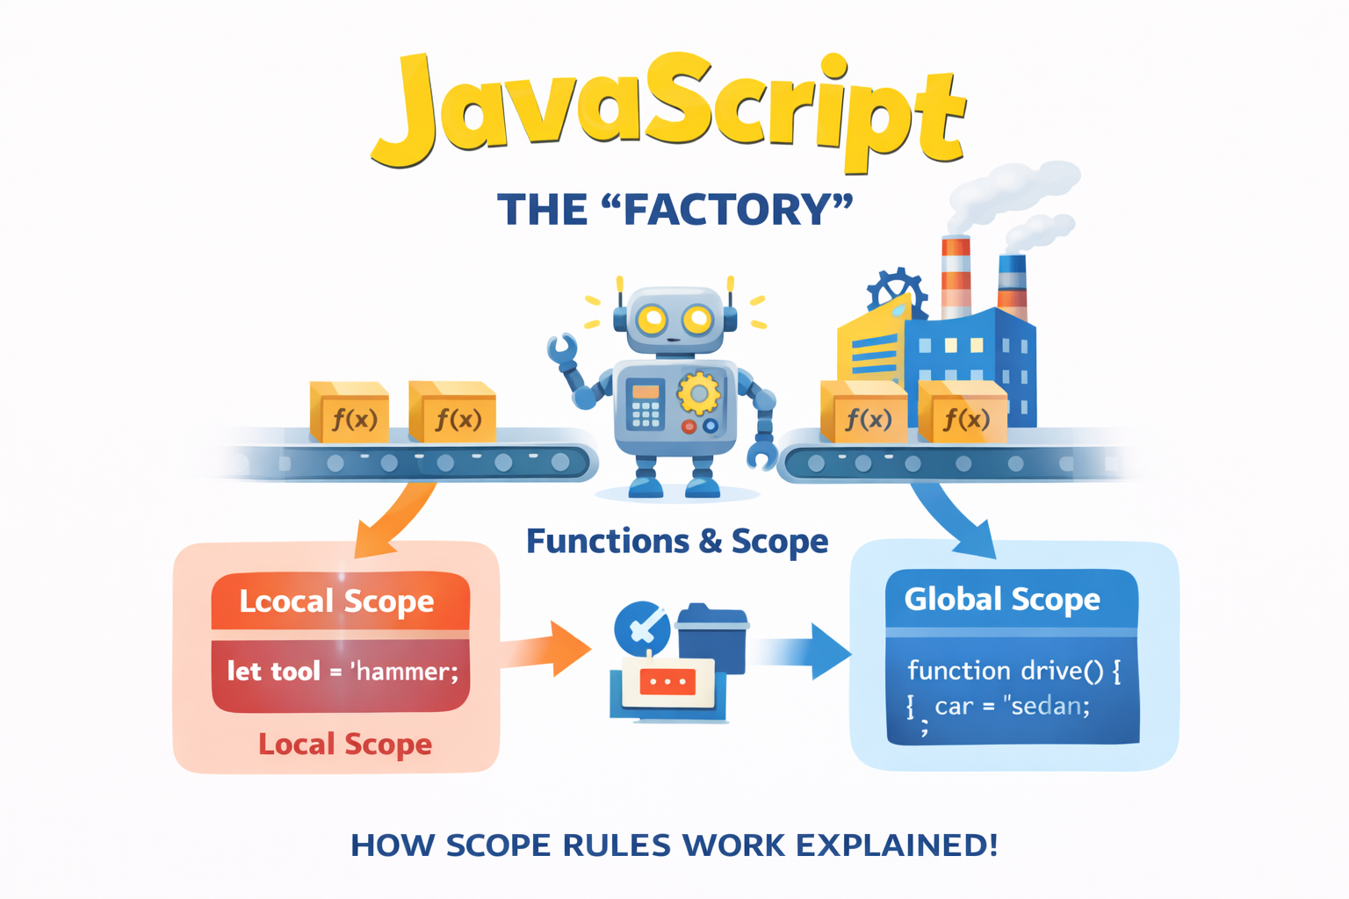
Part 3: The Factory

Slide 13
Functions
DRY Principle: Don’t Repeat Yourself
Function Declaration vs. Arrow Functions: Writing reusable blocks of code.
Parameters & Arguments: How to pass data into a function.
The return Keyword: Why it’s the most important part of a function.

Slide 14
Scope
Global vs. Local (Why variables inside a function stay inside a function).

Slide 15
Live Demo
Tip Calculator
Notes:
Create a function that takes billAmount and tipPercentage.
Calculate the total.
Return the result and log it to the console.

Slide 16
Lab #1
Grade Calculator
Implement a Grade Calculator as a function
Input: A numeric score (0-100).
Logic: If/Else chain to return 'A', 'B', 'C', or 'F'.
Output: console.log the result.

Slide 17
Lab #2
Smart Greeting
Implement a function that can give a customized greeting based on the time.
Create a variable for currentHour.
Write a function called getGreeting that takes hour as a parameter.
Inside the function, use if/else logic:
If < 12: Return "Good Morning"
If < 18: Return "Good Afternoon"
Else: Return "Good Evening"
Log the result of the function to the console.

Slide 18
Assignment #1 Feedback
TBA: Feedback on any common issues seen in the Assignment #1 submissions

Slide 19
Summary
1. Store it with const and let
Use const by default. Only use let if you know the value will change (like a counter).
2. Types Matter
JavaScript is "weakly typed," but adding a number to a string (e.g., 10 + "5") leads to "105". Always check your types!
3. If/Else is the Foundation
Every complex app (Netflix, Amazon, Uber) is just a massive collection of "If/Else" statements.
4. Functions are Reusable Tools
Don't repeat yourself (DRY principle). If you find yourself writing the same code twice, put it in a function.

